Slide 1
Loops. Error Handling. Strict mode.
By Anastasiia Khudnytska

Slide 2
Loops in JavaScript
Loops are used to execute the same block of code again and again, as long as a certain condition is met. The basic idea behind a loop is to automate the repetitive tasks within a program to save the time and effort. JavaScript now supports six different types of loops:
while — loops through a block of code as long as the condition specified evaluates to true.
do…while — loops through a block of code once; then the condition is evaluated. If the condition is true, the statement is repeated as long as the specified condition is true.
for — loops through a block of code until the counter reaches a specified number.
for…in — loops through the properties of an object.
for…of — loops over iterable objects such as arrays, strings, etc.
forEach — method for looping through arrays.

Slide 3
The while Loop
This is the simplest looping statement provided by JavaScript.
The while loop loops through a block of code as long as the specified condition evaluates to true. As soon as the condition fails, the loop is stopped. The generic syntax of the while loop is:
The following example defines a loop that will continue to run as long as the variable i is less than or equal to 5. The variable i will increase by 1 each time the loop runs:
while(condition) { // Code to be executed }
let i = 1;
while(i <= 5) {
document.write(<p>The number is " + i + "</p>");
i++;
}
The number is 1
The number is 2
The number is 3
The number is 4
The number is 5

Slide 4
The do...while Loop
The do-while loop is a variant of the while loop, which evaluates the condition at the end of each loop iteration. With a do-while loop the block of code executed once, and then the condition is evaluated, if the condition is true, the statement is repeated as long as the specified condition evaluated to is true. The generic syntax of the do-while loop is:
The JavaScript code in the following example defines a loop that starts with i=1. It will then print the output and increase the value of variable i by 1. After that the condition is evaluated, and the loop will continue to run as long as the variable i is less than, or equal to 5.
do { // Code to be executed } while(condition);
The number is 1
The number is 2
The number is 3
The number is 4
The number is 5
let i = 1;
do {
document.write(<p>The number is " + i + "</p>");
i++;
}
while(i <= 5);

Slide 5
Difference Between while and do...while Loop
The while loop differs from the do-while loop in one important way — with a while loop, the condition to be evaluated is tested at the beginning of each loop iteration, so if the conditional expression evaluates to false, the loop will never be executed.
With a do-while loop, on the other hand, the loop will always be executed once even if the conditional expression evaluates to false, because unlike the while loop, the condition is evaluated at the end of the loop iteration rather than the beginning.

Slide 6
The for Loop
The for loop repeats a block of code as long as a certain condition is met. It is typically used to execute a block of code for certain number of times. Its syntax is:
The parameters of the for loop statement have following meanings:
initialization — it is used to initialize the counter variables, and evaluated once unconditionally before the first execution of the body of the loop.
condition — it is evaluated at the beginning of each iteration. If it evaluates to true, the loop statements execute. If it evaluates to false, the execution of the loop ends.
increment — it updates the loop counter with a new value each time the loop runs.
for(initialization; condition; increment) { // Code to be executed }

Slide 7
The for Loop
The following example defines a loop that starts with i=1. The loop will continue until the value of variable i is less than or equal to 5. The variable i will increase by 1 each time the loop runs:
The for loop is particularly useful for iterating over an array. The following example will show you how to print each item or element of the JavaScript array.
The number is 1
The number is 2
The number is 3
The number is 4
The number is 5
for(var i=1; i<=5; i++) {
document.write("<p>The number is " + i + "</p>");
}
// An array with some elements
let fruits = ["Apple", "Banana", "Mango", "Orange", "Papaya"]; // Loop through all the elements in the array
for(var i=0; i<fruits.length; i++) {
document.write("<p>" + fruits[i] + "</p>");
}
Apple
Banana
Mango
Orange
Papaya

Slide 8
The for...in Loop
The for-in loop is a special type of a loop that iterates over the properties of an object, or the elements of an array. The generic syntax of the for-in loop is:
The loop counter i.e. variable in the for-in loop is a string, not a number. It contains the name of current property or the index of the current array element.
The following example will show you how to loop through all properties of a JavaScript object.
for(variable in object) { // Code to be executed }
// An object with some properties
let person = {"name": "Clark", "surname": "Kent", "age": "36"};
// Loop through all the properties in the object
for(let prop in person) {
document.write("<p>" + prop + " = " + person[prop] + "</p>");
}
name = Clark
surname = Kent
age = 36

Slide 9
The for...in Loop
Similarly, you can loop through the elements of an array, like this:
// An array with some elements
let fruits = ["Apple", "Banana", "Mango", "Orange", "Papaya"];
// Loop through all the elements in the array
for(let i in fruits) {
document.write("<p>" + fruits[i] + "</p>");
}
Apple
Banana
Mango
Orange
Papaya

Slide 10
The for...of Loop
ES6 introduces a new for-of loop which allows us to iterate over arrays or other iterable objects (e.g. strings) very easily. Also, the code inside the loop is executed for each element of the iterable object.
The following example will show you how to loop through arrays and strings using this loop.
// Iterating over array
let letters = ["a", "b", "c", "d", "e", "f"];
for(let letter of letters) {
console.log(letter); // a,b,c,d,e,f
}
// Iterating over string
let greet = "Hello World!";
for(let character of greet) {
console.log(character); // H,e,l,l,o, ,W,o,r,l,d,!
}

Slide 11
for…of Loops And Objects (won’t work)
for…of loops work only with iterable values. An object is not an iterable.
As a remedy you can first convert an object to an iterable using some of the built-in Object methods: .keys(), .values() or .entries():
let object = { a: 1, b: 2, c: 3 };
for (let value of object) // Error: object is not iterable console.log( value );
let enumerable = { property : 1, method : () => {} };
for (let key of Object.keys( enumerable )) console.log(key);
property
method
for (let value of Object.values( enumerable )) console.log(value);
1
() => {}
for (let entry of Object.entries( enumerable )) console.log(entry);
(2) ["property", 1]
(2) ["method", ƒ()]

Slide 12
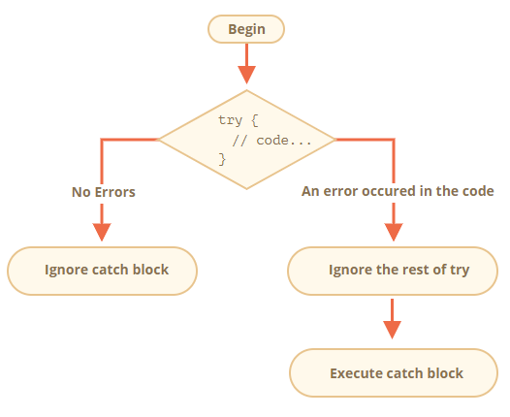
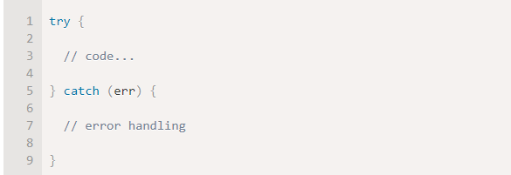
Error handling, "try..catch"
The try..catch construct has two main blocks: try, and then catch:
It works like this:
1) First, the code in try {...} is executed.
2) If there were no errors, then catch(err) is ignored: the execution reaches the end of try and goes on, skipping catch.
3) If an error occurs, then the try execution is stopped, and control flows to the beginning of catch(err). The err variable (we can use any name for it) will contain an error object with details about what happened.
So, an error inside the try {…} block does not kill the script – we have a chance to handle it in catch.

Slide 13
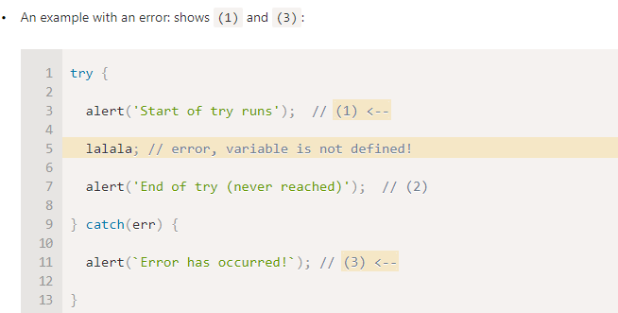
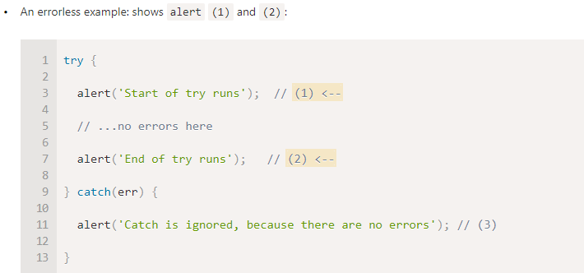
Example with an error

Slide 14
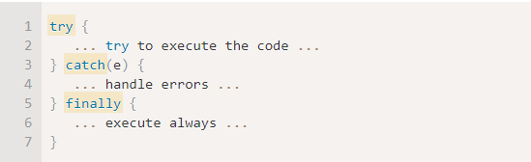
try…catch…finally
The try..catch construct may have one more code clause: finally.
If it exists, it runs in all cases:
after try, if there were no errors,
after catch, if there were errors.
The extended syntax looks like this:
The finally clause is often used when we start doing something and want to finalize it in any case of outcome.

Slide 15
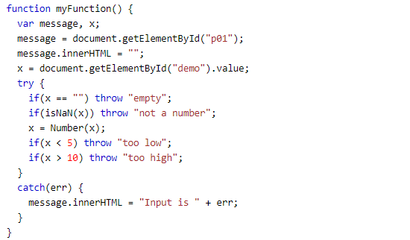
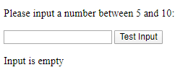
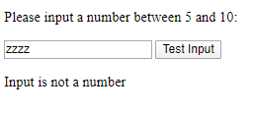
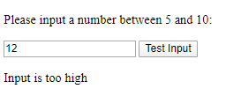
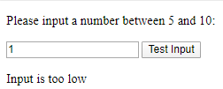
The throw Statement
The throw statement allows you to create a custom error.
Technically you can throw an exception (throw an error).
The exception can be a JavaScript String, a Number, a Boolean or an Object.
If you use throw together with try and catch, you can control program flow and generate custom error messages.

Slide 16
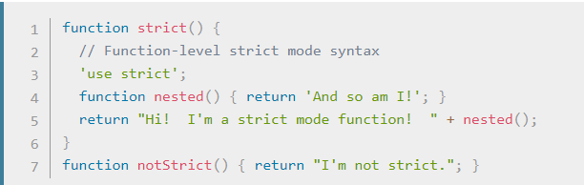
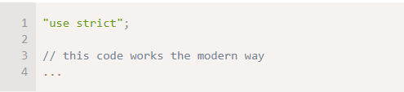
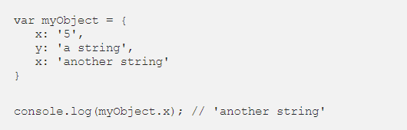

“use strict”
The directive looks like a string: "use strict" or 'use strict'. When it is located at the top of a script, the whole script works the “modern” way.
1) Illegal assignments
In Javascript, assigning values to protected
variables would fail silently. In strict mode,
it throws errors. For example, the following:
2) Duplicated properties in objects
In JavaScript you can define an object property twice or more: it will just take the last definition and override the previous ones:

Slide 17


“use strict”
3) Arguments in functions
In normal JavaScript, we can repeat arguments names in functions. The late occurrence of this arguments will override the previous ones:
4) Requires declaration of variables

Slide 18


